Slide 1
Hackathon Report -3
Name –Samyak Jain
Code - GSBSP-BR43

Slide 2
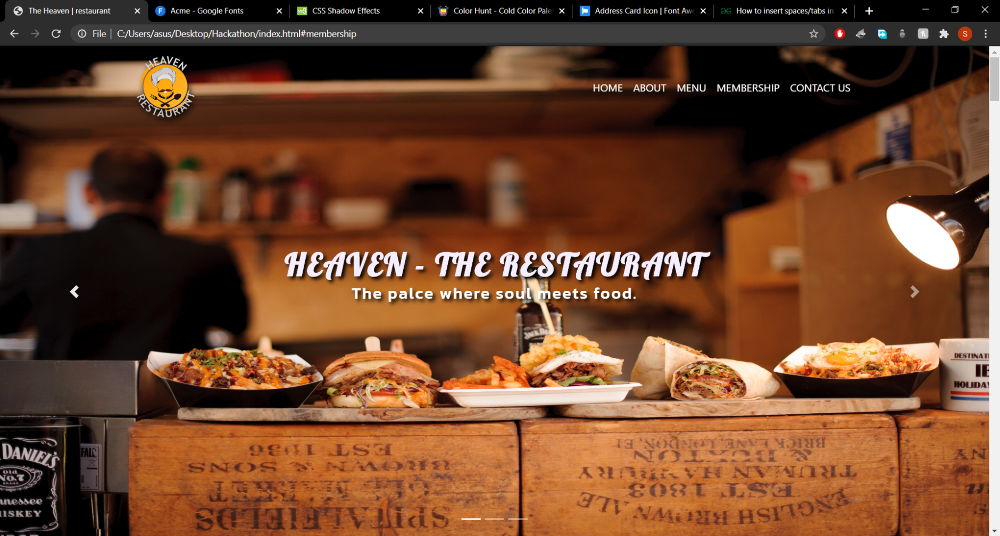
Added new fonts to the page along with styles and shadows for good design.

Slide 3
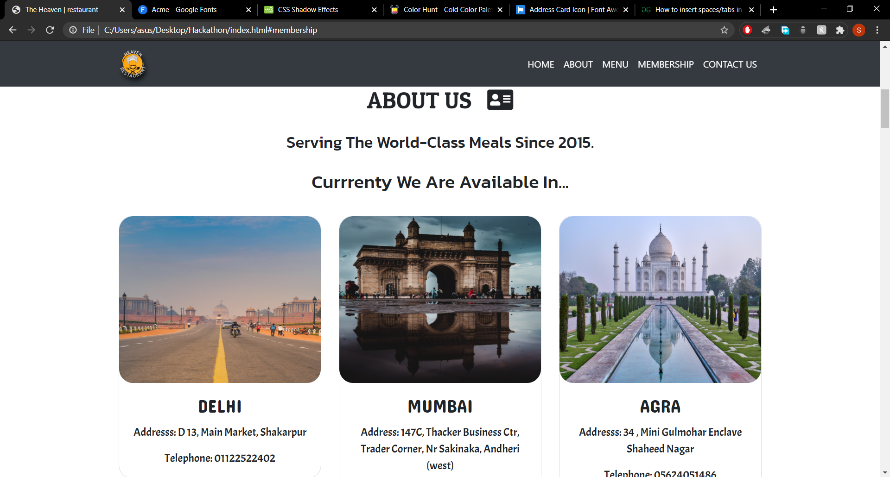
Font-styles,colors,icons are added to the specific place.

Slide 4
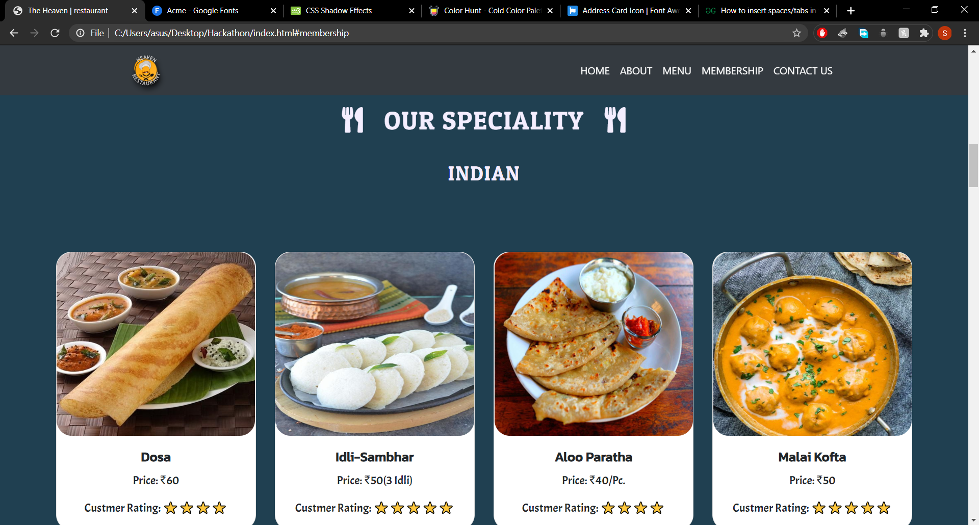
Menu section Updated with fonts , texts and background color.

Slide 5
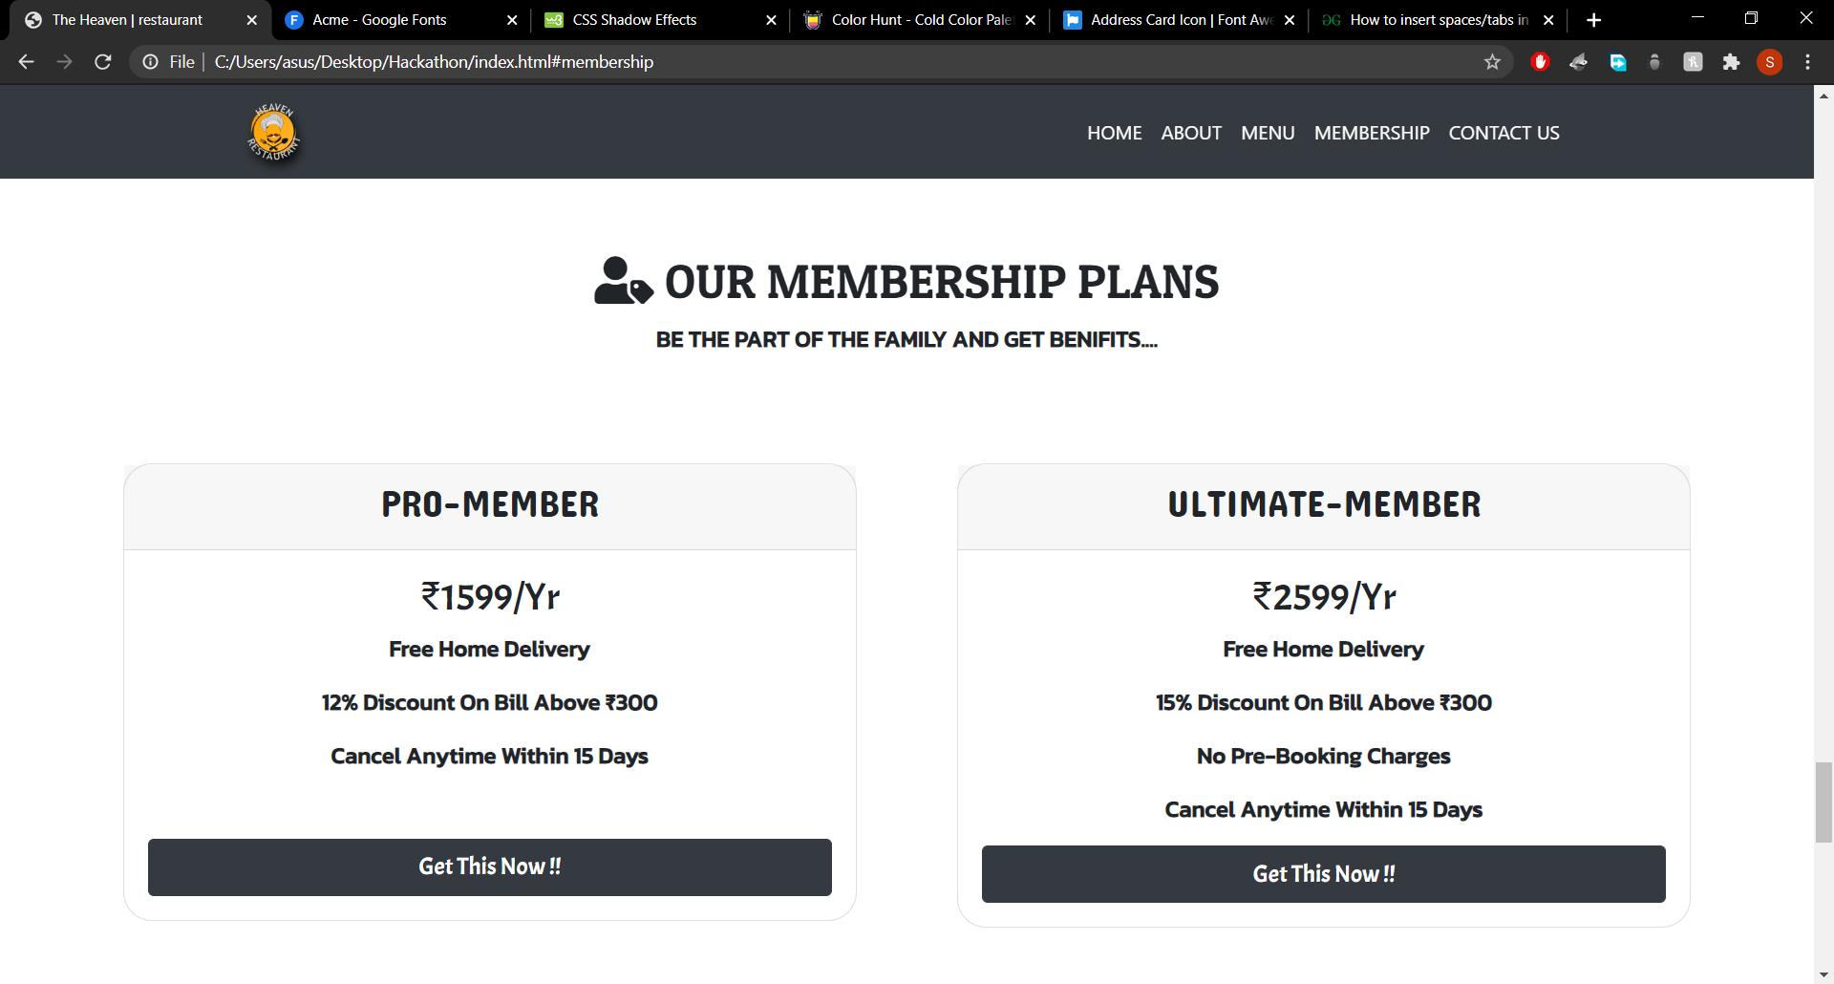
Added a feature of membership-plans for the Restaurant, with proper fonts and styles.

Slide 6
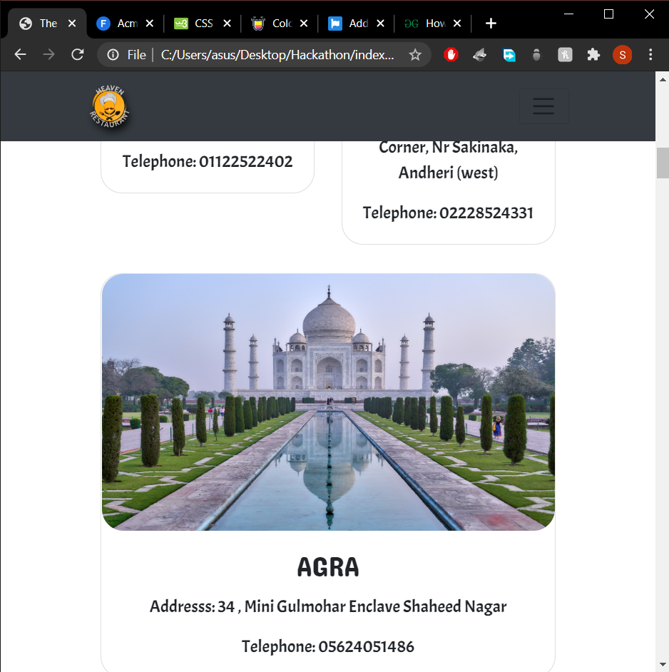
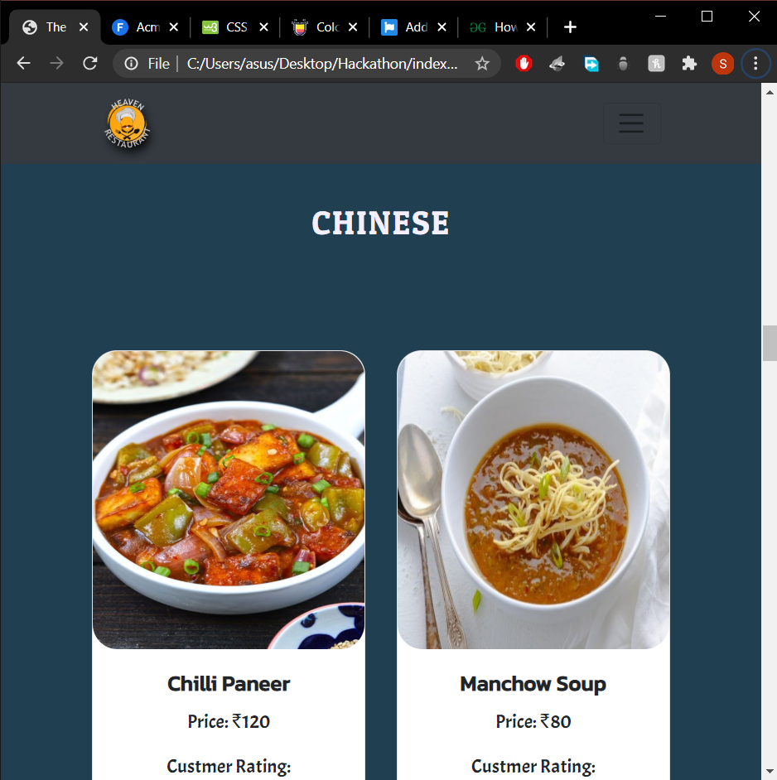
Responsiveness still mainteined perfectly.

Slide 7
Looking forward for…
Adding JavaScript animations.
Adding effects like scrolling(while click on links).

Slide 8
Thank You!!
Suggestions are always welcomed….

